Slide 2
define basic concepts of calendar,
elaborate the relationship among day, week, month and year.

Slide 3
Basic Concept of Calendar
Day | Month - Year
Sunday |  | 6 | 13 | 20 | 27
Monday |  | 7 | 14 | 21 | 28
Tuesday | 1 | 8 | 15 | 22 | 29
Wednesday | 2 | 9 | 16 | 23 | 30
Thursday | 3 | 10 | 17 | 24 | 31
Friday | 4 | 11 | 18 | 25
Saturday | 5 | 12 | 19 | 26
Week

Slide 4
Basic Concept of Calendar
Day | March - Year
Sunday |  | 6 | 13 | 20 | 27
Monday |  | 7 | 14 | 21 | 28
Tuesday | 1 | 8 | 15 | 22 | 29
Wednesday | 2 | 9 | 16 | 23 | 30
Thursday | 3 | 10 | 17 | 24 | 31
Friday | 4 | 11 | 18 | 25
Saturday | 5 | 12 | 19 | 26
Fundamental Unit

Slide 5
Basic Concept of Calendar
Week
Sunday
Monday
Tuesday
Wednesday
Thursday
Friday
Saturday
7 Days
= Week

Slide 6
Basic Concept of Calendar
Month
Collection - Specified Number of Days
January February March
April May June
July August September
October November December

Slide 7
Basic Concept of Calendar
Day | February – Non-leap Year
Sunday |  | 6 | 13 | 20 | 27
Monday |  | 7 | 14 | 21 | 28
Tuesday | 1 | 8 | 15 | 22
Wednesday | 2 | 9 | 16 | 23
Thursday | 3 | 10 | 17 | 24
Friday | 4 | 11 | 18 | 25
Saturday | 5 | 12 | 19 | 26

Slide 8
Basic Concept of Calendar
Day | February – Non-leap Year
Sunday |  | 6 | 13 | 20 | 27
Monday |  | 7 | 14 | 21 | 28
Tuesday | 1 | 8 | 15 | 22 | 29
Wednesday | 2 | 9 | 16 | 23
Thursday | 3 | 10 | 17 | 24
Friday | 4 | 11 | 18 | 25
Saturday | 5 | 12 | 19 | 26

Slide 9
Basic Concept of Calendar
Day | April, June, September, and November
Sunday |  | 6 | 13 | 20 | 27
Monday |  | 7 | 14 | 21 | 28
Tuesday | 1 | 8 | 15 | 22 | 29
Wednesday | 2 | 9 | 16 | 23 | 30
Thursday | 3 | 10 | 17 | 24
Friday | 4 | 11 | 18 | 25
Saturday | 5 | 12 | 19 | 26

Slide 10
Basic Concept of Calendar
Day | January, March, May, July, August, October, and December
Sunday |  | 6 | 13 | 20 | 27
Monday |  | 7 | 14 | 21 | 28
Tuesday | 1 | 8 | 15 | 22 | 29
Wednesday | 2 | 9 | 16 | 23 | 30
Thursday | 3 | 10 | 17 | 24 | 31
Friday | 4 | 11 | 18 | 25
Saturday | 5 | 12 | 19 | 26

Slide 11


Basic Concept of Calendar
Year

Slide 12
Basic Concept of Calendar
Relation among Day, Week, Month, and Year
A day
  7th part of the week;
  28th or 29th or 30th or 31st part of a month;
  365th part of the Lunar year or 366th part of the leap year.

Slide 13
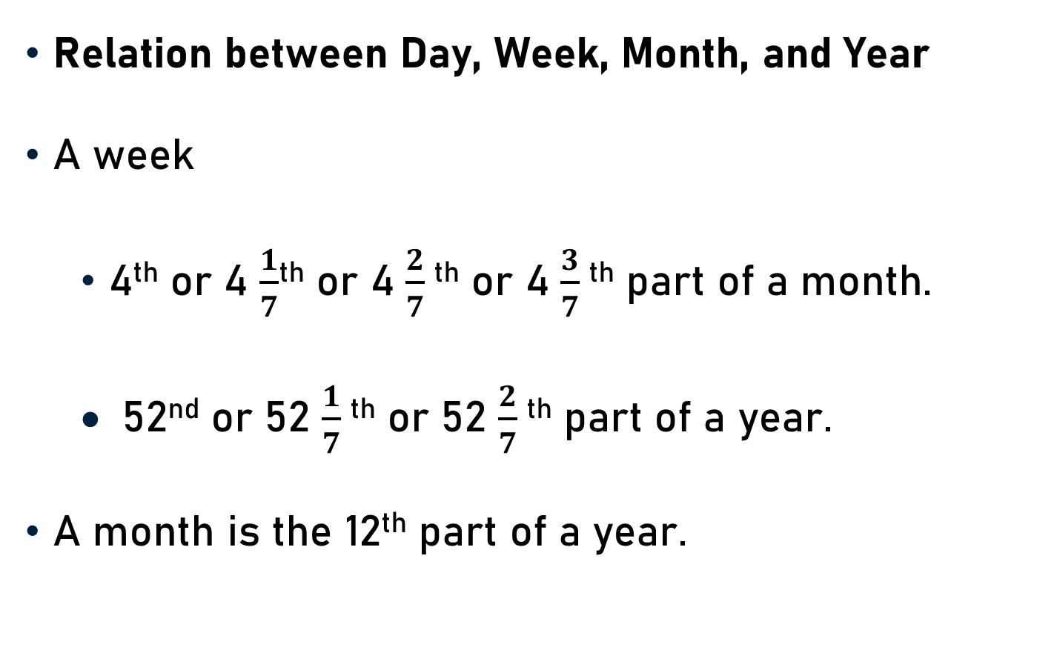
Basic Concept of Calendar
Relation between Day, Week, Month, and Year
A week
  4th or 4 $\frac{1}{7}$^{th} or 4 $\frac{2}{7}$^{th} or 4 $\frac{3}{7}$^{th} part of a month.
  52nd or 52 $\frac{1}{7}$^{th} or 52 $\frac{2}{7}$^{th} part of a year.
A month is the 12th part of a year.

Slide 14
Basic Concept of Calendar
Date
  Number/Digit - Each Day
  That Part of a Month
  365th Part of the Year - Lunar Year
  366th Part of the Year - Leap Year

Slide 15
Basic Concept of Calendar
Century
  Set/Group - 100 Years
  100, 200, 300, 400, 500, 600, 700, and so on.
  400, 800, 1200, 1600, 2000, 2400, etc.

Slide 16
Basic Concept of Calendar
Ordinary Year
  365 Days
  52 Full Weeks and One Extra Day
  Not Exactly Divisible by 4
  For Example, 2010, 2011, 2021, 2022, etc.

Slide 17
Basic Concept of Calendar
Leap Year
  366 days
  52 Full Weeks and Two Extra Days
  Exactly Divisible by 4
  For example, 2012, 2016, 2020, 2024, etc.

Slide 18
Basic Concept of Calendar
First day of a century
- Monday, Tuesday, Thursday, or Saturday
Last day of a century
- cannot be Tuesday, Thursday, or Saturday

Slide 19
Basic Concept of Calendar
April & July for all years
- Same Calendar
January and October for non-leap years
- Same Calendar

Slide 20
Basic Concept of Calendar
The calendars of two different years are same if –
  Both years are either ordinary years or leap years.
  January 21 of both years must be the same day of the week.

Slide 21
Conclusion
Basic Concepts of Calendar
  Calendar
  Day
  Week
  Month
  Year
  Date
  Century
  Leap and Ordinary Year

Slide 22
Summary
Basic Concepts of Calendar
Relationship among Day, Week, Month and Year
First & Last day of Century

